Slide 1
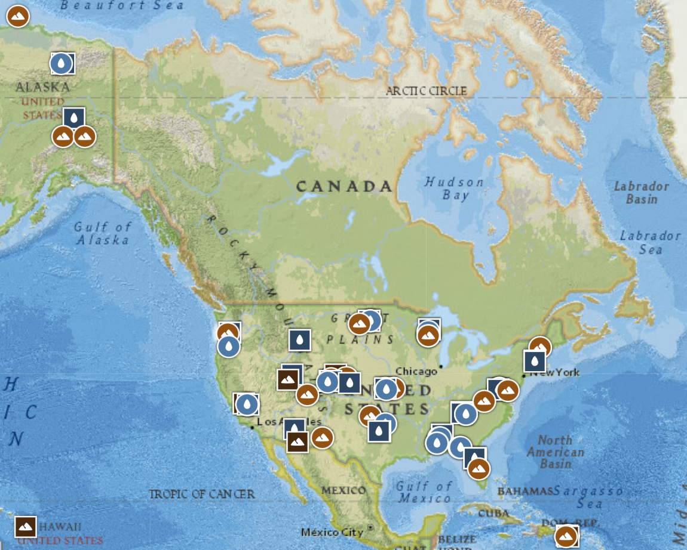
TOOL
CARI
LIRO
BARR
BONA
PRPO
WOOD
PRLA
DCFS
TOOK
CRAM
OKSR
UNDE
BLDE
TREE
HEAL
YELL
STEI
REDB
BART
DEJU
HARV
MART
NOGP
HOPB
ABBY
MCRA
BARC
DSNY
WREF
ONAQ
SYCA
GUIL
PRIN
CUPE/STCU
Blue = Water
Orange = Benthic
Green = Soil
BLUE
SRER
JORN
OAES
CLBJ
FLNT
GUAN
PUUM
LAJA
Notes:
Notes:
Over high latitude or longitude is there a pattern?
Over different biomes (in a forest, there are sub forests in biome and does it show any biome pattern?
Color has to be constant to all soil or water and just change the pattern or of the background of the chart!!! ***** Find a way to show the biome(in different soil sample like rocks

Slide 2
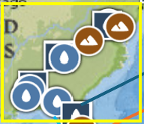
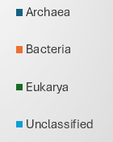
MLBS
POSE
BLAN
SCBI
MAYF
TALL
WALK
LEWI
SERC
LECO
BLWA
JERC
SUGG
DELA
ORNL
OSBS
GRSM
LENO
TOMB

Slide 3

SJER
SOAP
TECR
TEAK
BIGC

Slide 4

NIWO
KONA
STER
COMO
RMNP
KING
KONZ
CPER
UKFS
WLOU
ARIK
MOAB
MCDI

